Slide 1
Builder

Slide 2
Definition
What is this?

Slide 3
Definition
Builder is a creational design pattern that lets you construct complex objects step by step. The pattern allows you to produce different types and representations of an object using the same construction code.

Slide 4

Definition
Creational design patterns provide various object creation mechanisms, which increase flexibility and reuse of existing code.

Slide 5
Motivation
Why would we use this?

Slide 6
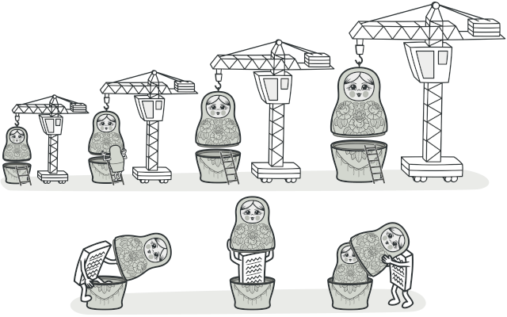
Problem
Imagine a complex object that requires laborious, step-by-step initialization of many fields and nested objects. Such initialization code is usually buried inside a monstrous constructor with lots of parameters. Or even worse: scattered all over the client code.

Slide 7
Solution
The simplest solution is to extend the base House class and create a set of subclasses to cover all combinations of the parameters. But eventually you’ll end up with a considerable number of subclasses. Any new parameter, such as the porch style, will require growing this hierarchy even more.

Slide 8
Solution
There’s another approach that doesn’t involve breeding subclasses. You can create a giant constructor right in the base House class with all possible parameters that control the house object. While this approach indeed eliminates the need for subclasses, it creates another problem.

Slide 9
Solution
The Builder pattern suggests that you extract the object construction code out of its own class and move it to separate objects called builders.

Slide 10
Examples
Where can we apply this?

Slide 11
Example

Slide 12
Example

Slide 13
Applicability
When should we use this?

Slide 14
Applicability
Where and when Builder pattern is applicable:
Use the Builder pattern to get rid of a “telescopic constructor”.
Use the Builder pattern when you want your code to be able to create different representations of some product (for example, stone and wooden houses).
Use the Builder to construct Composite trees or other complex

Slide 15
Applicability
Where and when Builder pattern is applicable:
Use the Builder pattern to get rid of a “telescopic constructor”.
Use the Builder pattern when you want your code to be able to create different representations of some product (for example, stone and wooden houses).
Use the Builder to construct Composite trees or other complex

Slide 16
Applicability
Where and when Builder pattern is applicable:
Use the Builder pattern to get rid of a “telescopic constructor”.
Use the Builder pattern when you want your code to be able to create different representations of some product (for example, stone and wooden houses).
Use the Builder to construct Composite trees or other complex

Slide 17
Applicability
Where and when Builder pattern is applicable:
Use the Builder pattern to get rid of a “telescopic constructor”.
Use the Builder pattern when you want your code to be able to create different representations of some product (for example, stone and wooden houses).
Use the Builder to construct Composite trees or other complex

Slide 18
Structure
How do we implement this?

Slide 19
Structure
Product – The product class defines the type of the complex object that is to be generated by the builder pattern.

Slide 20
Structure
Product – The product class defines the type of the complex object that is to be generated by the builder pattern.
Builder – This abstract base class defines all of the steps that must be taken in order to correctly create a product. Each step is generally abstract as the actual functionality of the builder is carried out in the concrete subclasses. The GetProduct method is used to return the final product. The builder class is often replaced with a simple interface.

Slide 21
Structure
ConcreteBuilder – There may be any number of concrete builder classes inheriting from Builder. These classes contain the functionality to create a particular complex product.

Slide 22
Structure
ConcreteBuilder – There may be any number of concrete builder classes inheriting from Builder. These classes contain the functionality to create a particular complex product.
Director – The director class controls the algorithm that generates the final product object. A director object is instantiated and its Construct method is called. The method includes a parameter to capture the specific concrete builder object that is to be used to generate the product. The director then calls methods of the concrete builder in the correct order to generate the product object.

Slide 23
Diagram

Slide 24
The code
The fun part

Slide 25
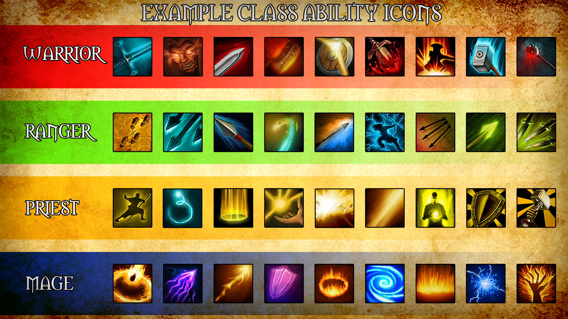
Example
Abilities in a game

Slide 26


Slide 28


The Product

Slide 29
The Director

Slide 30
The Builder

Slide 31
The Concrete Builder

Slide 32
The Concrete Builder

Slide 33
The Concrete Builder

Slide 34
The Concrete Builder

Slide 35
The Concrete Builder

Slide 36
The Concrete Builder

Slide 37
Client code
The grand finale

Slide 39
Conclusion
What we’ve learned today

Slide 40
Pros and Cons

Slide 41
Pros and Cons
You can construct objects step-by-step, defer construction steps or run steps recursively.

Slide 42
Pros and Cons
You can construct objects step-by-step, defer construction steps or run steps recursively.
You can reuse the same construction code when building various representations of products.

Slide 43
Pros and Cons
You can construct objects step-by-step, defer construction steps or run steps recursively.
You can reuse the same construction code when building various representations of products.
Single Responsibility Principle. You can isolate complex construction code from the business logic of the product.

Slide 44
Pros and Cons
You can construct objects step-by-step, defer construction steps or run steps recursively.
The overall complexity of the code increases since the pattern requires creating multiple new classes.
You can reuse the same construction code when building various representations of products.
Single Responsibility Principle. You can isolate complex construction code from the business logic of the product.

Slide 45
Conclusion
What is Builder:

Slide 46
Conclusion
What is Builder: It’s a creational design pattern that lets you construct complex objects step by step and allows you to produce different types and representations of an object using the same construction code.

Slide 47
Conclusion
What is Builder: It’s a creational design pattern that lets you construct complex objects step by step and allows you to produce different types and representations of an object using the same construction code.
When it is good to use it :

Slide 48
Conclusion
What is Builder: It’s a creational design pattern that lets you construct complex objects step by step and allows you to produce different types and representations of an object using the same construction code.
When it is good to use it : An application needs to create the elements of a complex aggregate

Slide 49
Conclusion
Structure :

Slide 50
Conclusion
Structure :

Slide 51


Questions
Any questions?

Slide 52

Thanks!
Thank you!

